Slide 1
Case Study: A Stochastic Inspection System
Optimization via simulation
Dr. Xueping Li, University of Tennessee

Slide 2
Preparation:
Hold Module
How to create a “signal” module?

Slide 3
A Stochastic Inspection System
In a nuclear plant, some parts that need inspection (or some special treatment) arrive according to a Poisson process with rate Lumbda. Every T time units the system is inspected and at each inspection time all messages present (if any) are cleared from the system (this process takes almost no time). A fixed cost of K>0 is incurred for each inspection. Also, for each item there is a holding cost of h>0 per unit time the item has to wait before it is cleared from the system. We wish to determine the optimal value of T for which the long-run average cost per unit time is minimal.
Let K=50, h=1, Lumbda=1. What’s the T*?
How about K=500, h=0.01, Lumbda=1?

Slide 4
Build the model

Slide 5
Discussions
How to find out the optimal T*?
Trial & error
Optimization techniques/DOE

Slide 6
OptQuest
Steps
Build a base model
Identify control/decision variables
Create an “optimization” model – OptQuest
Change the decision variables from “fix” to “design”
Configure parameters, constraints, replications etc.
Optimize!

Slide 7
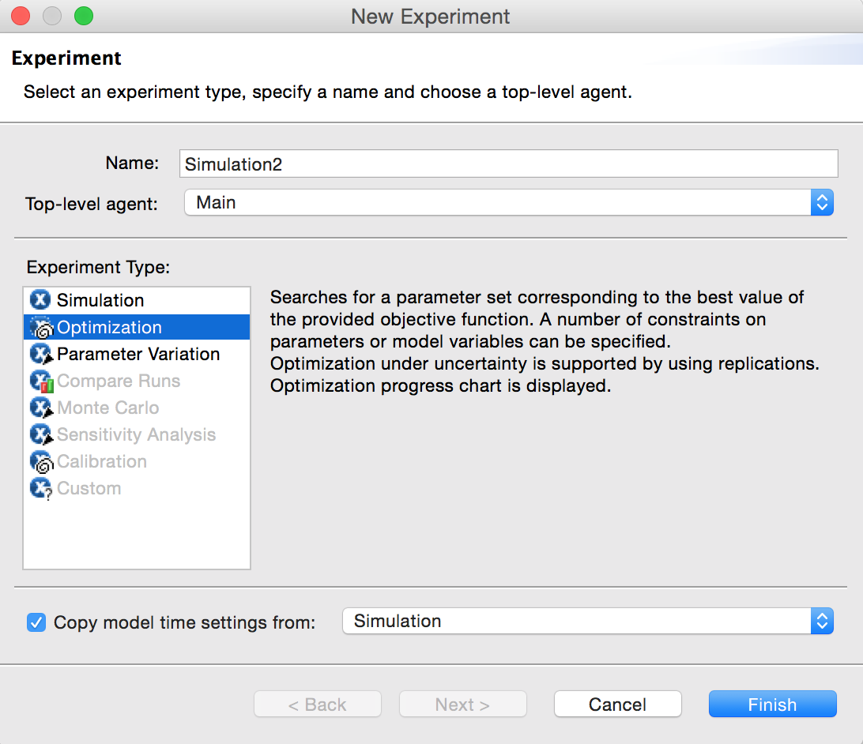
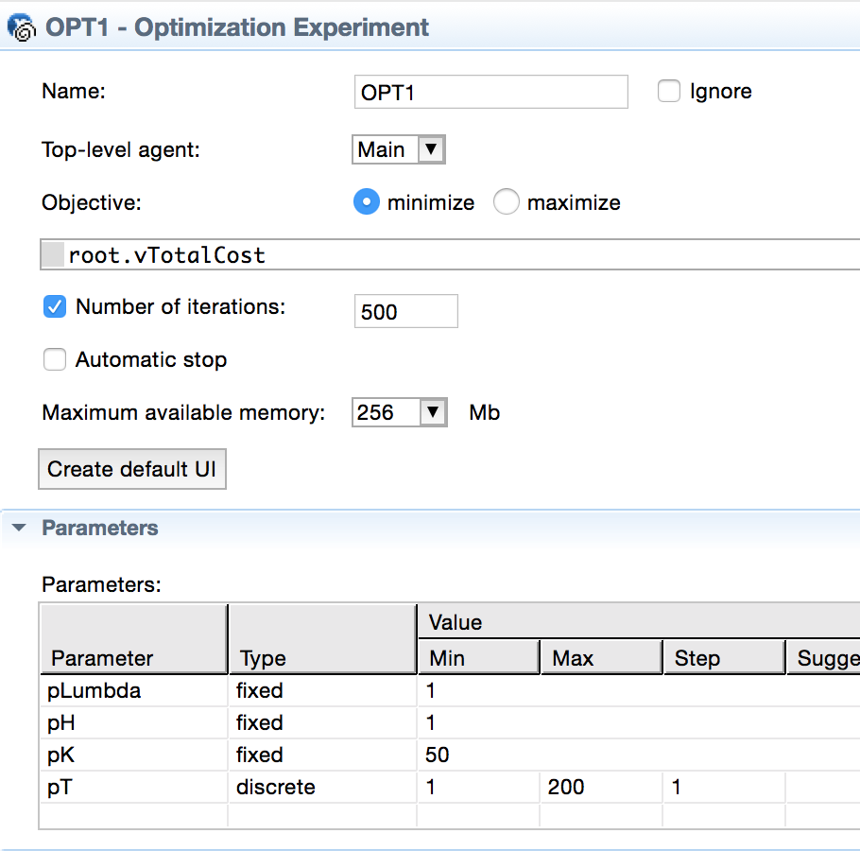
OptQuest

Slide 8
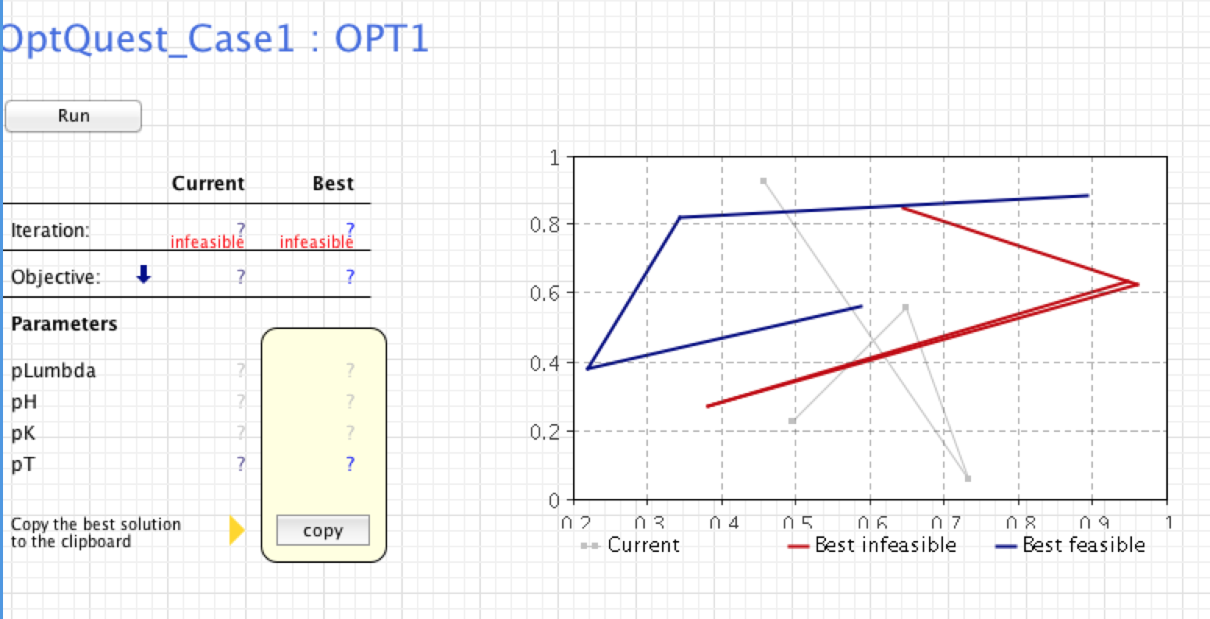

Slide 9
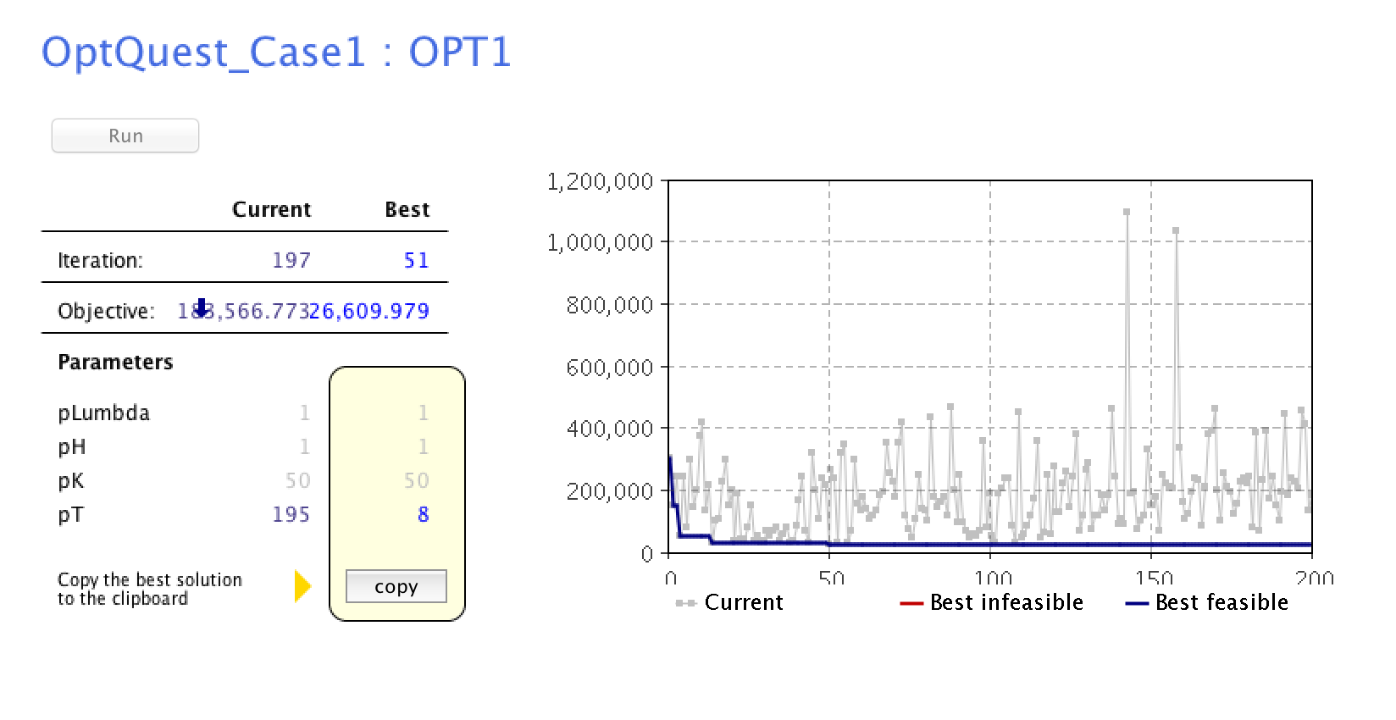

Slide 10
Closed form
T* = Sqrt(2K/(h*Lambda))

Slide 11
Extension?
What if the holding cost is f(n_t) per time unit, in which n_t is the number of items and f is a function, e.g., f(x) = xlog(x+5)?

